Slide 1


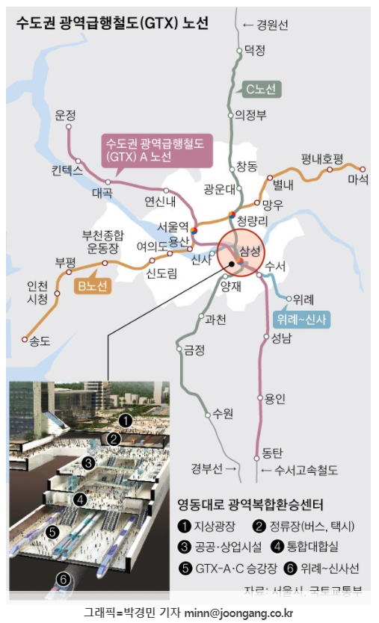
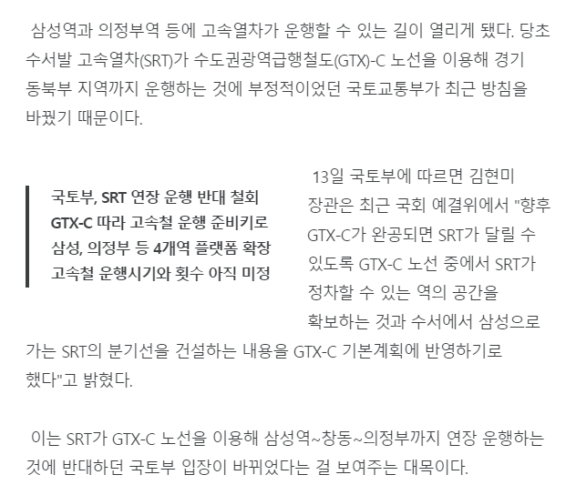


SRT - 청량리역 관련
https://news.joins.com/article/23919868

Slide 2
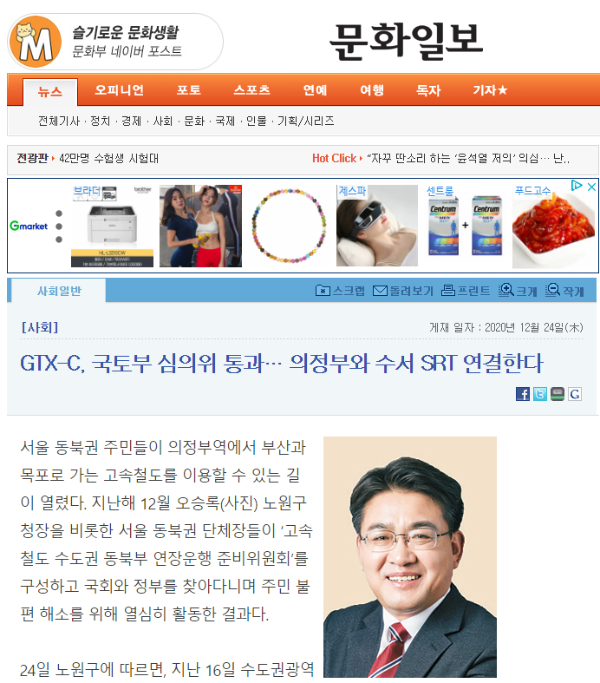
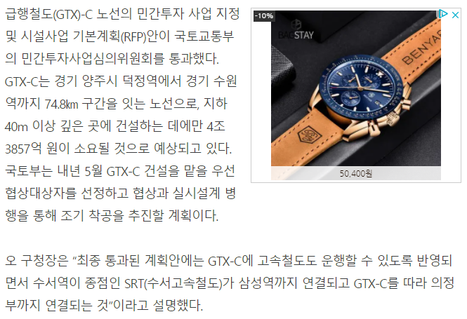
SRT - 청량리역 관련
http://www.munhwa.com/news/view.html?no=2020122401071003021001

