Slide 1
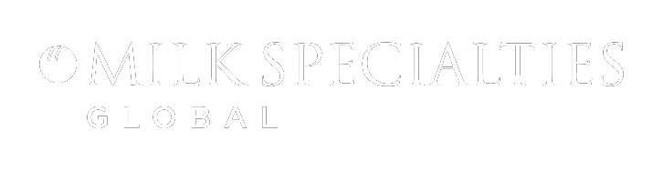

Confidential
M I L K S P E C I A L T I E S G L O B A L O V E R V I E W
P R O V I D I N G N U T R I T I O N A L S O L U T I O N S T O T H E W O R L D
|
Milk Specialties Global |

Slide 2

H i s t o r y o f m i l k s p e c i a l t i e s g l o b a l
1949
Midwest Dried Whey, Inc
1965
Milk Specialties Company
1970
Expansion into Animal Nutrition
2008
Expansion into Human Nutrition
|
Milk Specialties Global |

Slide 3


W E A R E A L E A D E R I N W H E Y P R O T E I N P R O D U C T I O N
1949
MIDWEST DRIED WHEY, INC
1965
MILK SPECIALTIES COMPANY
1970’s – 90’s
EXPANSION & FOCUS IN ANIMAL NUTRITION
2000’s - Present
EXPANSION INTO HUMAN NUTRITION
휴먼 뉴트리션
동물 뉴트리션
공동 제조
− 스포츠 뉴트리션
− 건강 관련 뉴트리션
− 스포트 뉴트리션 제품 계약 제조
|
Milk Specialties Global |

Slide 4

m o d u l a r b u s i n e s s p l a t f o r m
Human Nutrition
Active Nutrition
Health & Wellness
Functional Foods
WPC/WPI
Lactose
Secure Access to Raw Material
MPC/MPI
Permeate
Whey Stream
100% Whey/ Milk. Cream Capture
Milk
Fat
Prilled Fats
Milk Replacer
Animal Nutrition
Permeate
PEF
Dairy Animals
Livestock Producers
|
Milk Specialties Global |

Slide 5
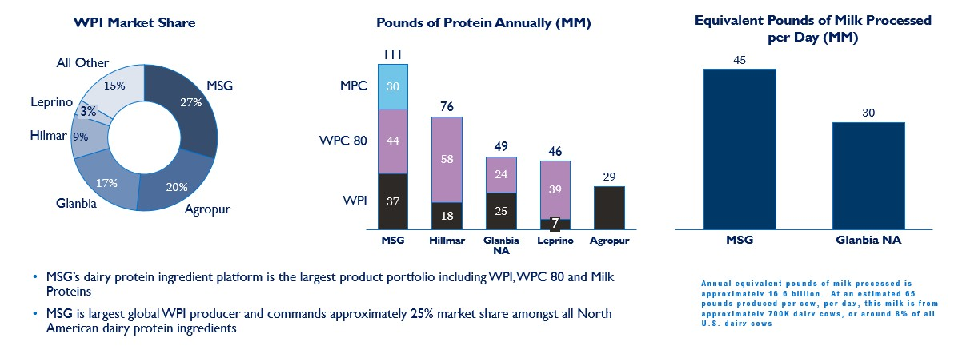
S i g n i f i c a n t S c a l e i n P r o t e i n P r o c e s s i n g
MS社의 유제품 프로틴 원료 플랫폼이 WPI, WPC80, 밀크 프로틴을 포함해서 가장 큰 것으로 나타남
MS社는 가장 큰 WPI 원료 생산 업체이며, 북미 유제품 원료 부분에 있어 25%의 시장 점유율 차지
|
Milk Specialties Global |

Slide 6
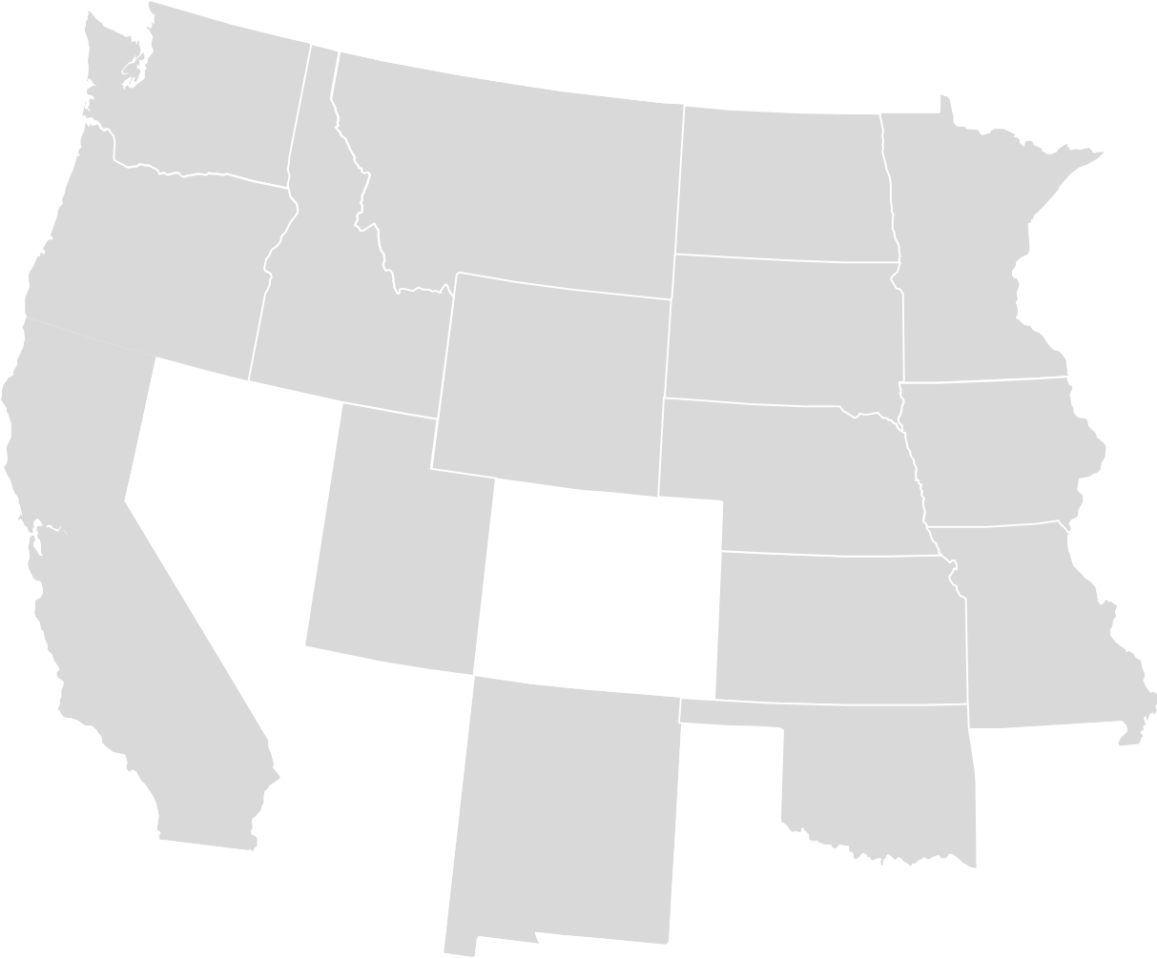
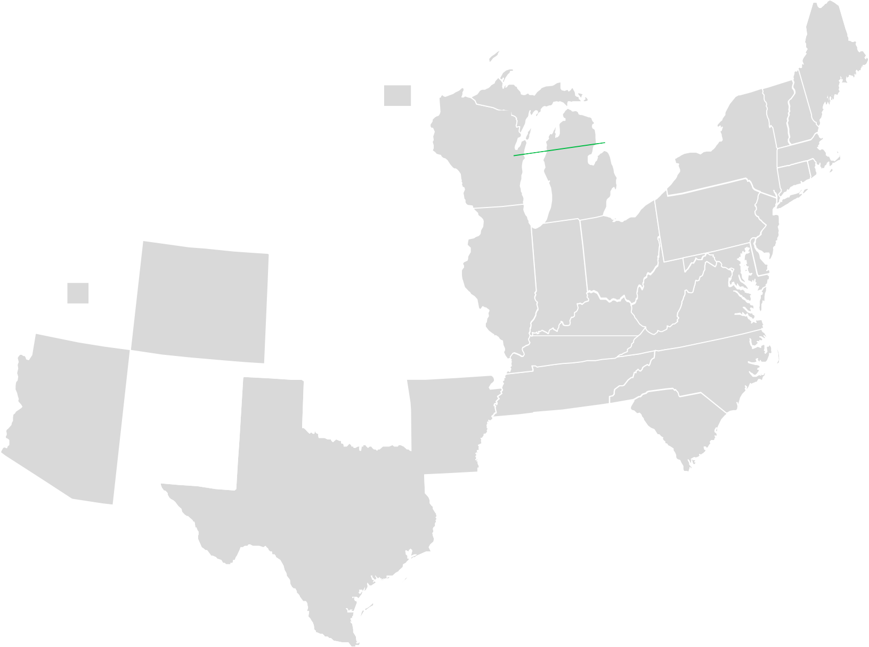
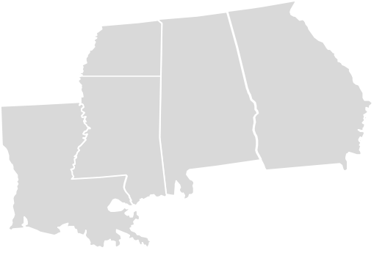

F a c i l i t y n e t w o r k
MN
New Holstein Fond du Lac
휴먼 뉴트리션 생산 공장 위치
Fond du Lac, WI
Eden Prairie Mountain Lake
Wautoma
WI
Adell
Mountain Lake, MN
Visalia, CA
Norfolk, NE
Wautoma, WI
Monroe, WI
Boscobel
Monroe
IL
Norfolk
NE
CA
Paris
Visalia
동물 뉴트리션 생산 공장 위치
Paris, IL
Boscobel, WI
New Holstein, WI
Adell, WI
휴먼 뉴트리션 본사
동물 뉴트리션
Facilities
|
Milk Specialties Global |

Slide 7
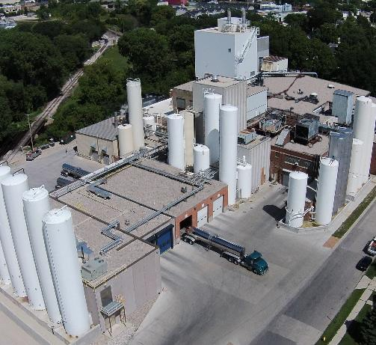
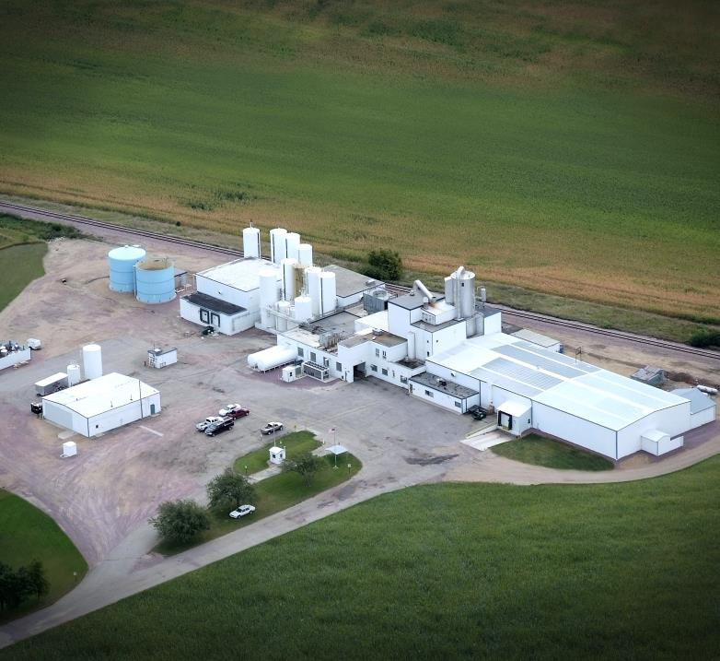
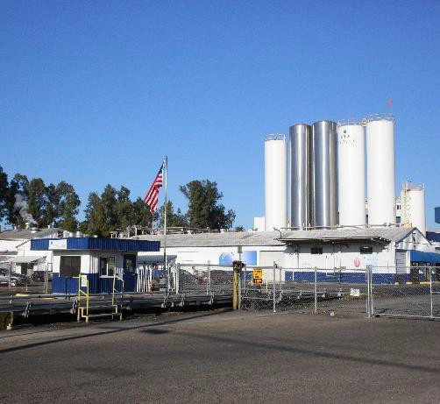
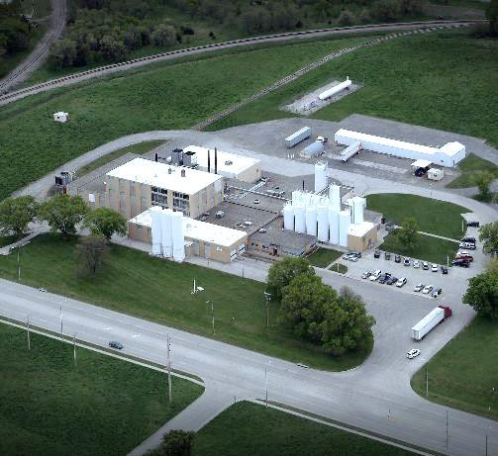
휴먼 뉴트리션 공장별 취급 원료
Fond du Lac, WI
Whey Protein Isolates, Concentrates and Hydrolysates
Mountain Lake, MN
Whey Protein Isolates, Concentrates and Hydrolysates Visalia, CA
Milk Protein Concentrates and Isolates
Norfolk, NE
Whey and Milk Proteins, Organic Ingredients
|
Milk Specialties Global |

Slide 8


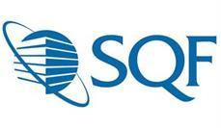

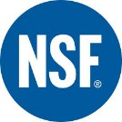





보유 서티 리스트
SQF Level II Certified by NSF
Visalia, Fond du Lac, Wautoma, Boscobel, Mountain Lake, Norfolk
With this level of SQF certification, our plants are part of a certified HACCP food safety plan that is benchmarked by the GFSI (Global Food Safety Initiative)
Non-GMO Project Verified NOP Certified
Validus Certified
Kosher & Halal Certified
|
Milk Specialties Global |

Slide 9

휴먼 뉴트리션 사업 부분 주요 핵심 원료
ORGANIC
rBGH Free
Non-GMO
Kosher
Halal
Grass-fed
WHEY PROTEIN
MILK PROTEIN
BRANDED INGREDIENTS
Whey Protein Concentrate 34%-80%
- Regular and KwikMix™ Instant
Milk Protein Concentrates 70%-80%
- Regular and KwikMix™ Instant
PRObev™ - clear whey proteins
BARs o f t ™ - high proteins for bars
ZERLAC™ - lactose f ree protein isolates CASPRO™ - MCC/ Micellar Casein
Whey Protein Isolate 90%
- Regular and KwikMix™ Instant
Milk Protein Isolate 90%
- Regular and KwikMix™ Instant
Multa PRO™ - high proteins for yogurts
Whey Protein Hydrolysates
- DH 3-20
- Regular and KwikMix™ Instant
NEW OFFERINGS
Calcium Caseinate
- Regular and KwikMix™ Instant
Sodium Casein
PROriz (Rice Protein)
MFGM (Milk Fat Globule Membrane)
Alpha Lactalbumin WPI 90 Lactoferrin Enriched WPI 90 IgG Enriched WPC
Prebiotic WPC80
Heat Stable
- WPC 70, 80 and 90
Protein Crisps – Milk and Whey
|
|
Milk Specialties Global |
Confidential
Milk Specialties Global
|
August 8, 2020
Microparticulated WPC80

Slide 10
휴먼 뉴트리션 사업 부분 주요 핵심 원료
Sweet Whey Powder
WPC 34
Lactose
Food grade
Feed grade
Food Grade 80 -100 mesh
Food Grade 60 -100 mesh
Feed Grade
Organic lactose
|
|
Milk Specialties Global |
Confidential
Milk Specialties Global
|
August 8, 2020

Slide 11
MS社 강점
영양 및 기능 응용 분야에 가장 광범위한 맞춤형 유청 및 우유 단백질 원료를 보유하고 있음.
모듈형 비즈니스 플랫폼 (modular business platform)으로 인해 고객 지원 시 제한이 없음.
고단백 유청 원료를 생산하는 가장 큰 생산 업체.
|
Milk Specialties Global |

